Slide 1
Effects of increased home size on the green cover in Los Angeles County’s single-family neighborhoods
Su Jin Lee¹, Travis Longcore^{1,2}, Catherine Rich³, and John Wilson¹
¹Spatial Sciences Institute, University of Southern California
² School of Architecture, University of Southern California
³ The Urban Wildlands Group, Los Angeles, CA
The Huntington, San Marino, CA
January 17, 2019

Slide 2
Inequality of tree cover distribution
Less tree cover
More tree cover
Introduction | 2

Slide 3
Square feet of floor area in new single-family houses completed between 1999 - 2014
Percent distribution (%)
Source: http://www.census.gov/construction/chars/completed.html
Introduction | 3

Slide 4
Number of bedrooms in new single-family houses completed between 1973 - 2014
Percent distribution (%)
Source: http://www.census.gov/construction/chars/completed.html
Introduction | 4

Slide 5
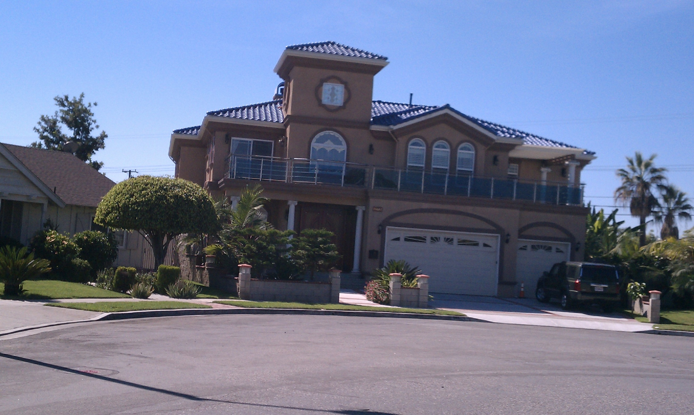
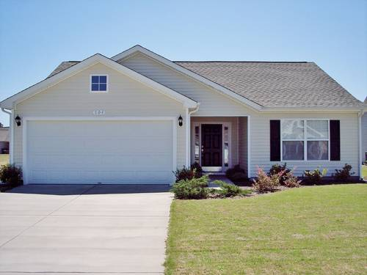
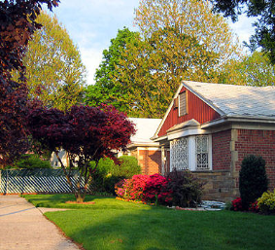
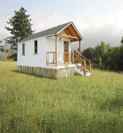
Increasing home sizes limits space for nature
1950
983 ft²
1970
1,500 ft²
1990
2,080 ft²
2004
2,349 ft²
Introduction | 5

Slide 6
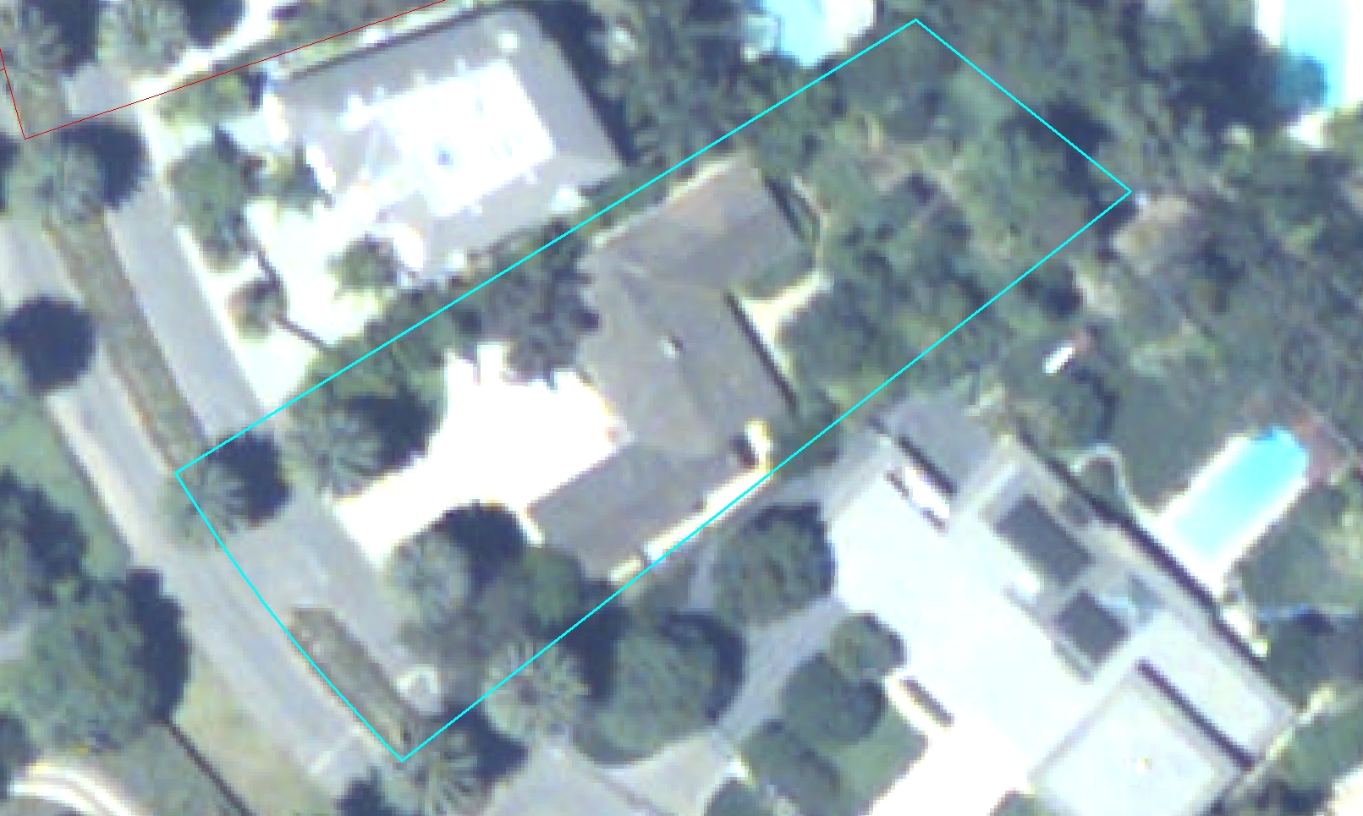
Small home surrounded by green cover
Introduction | 6

Slide 7
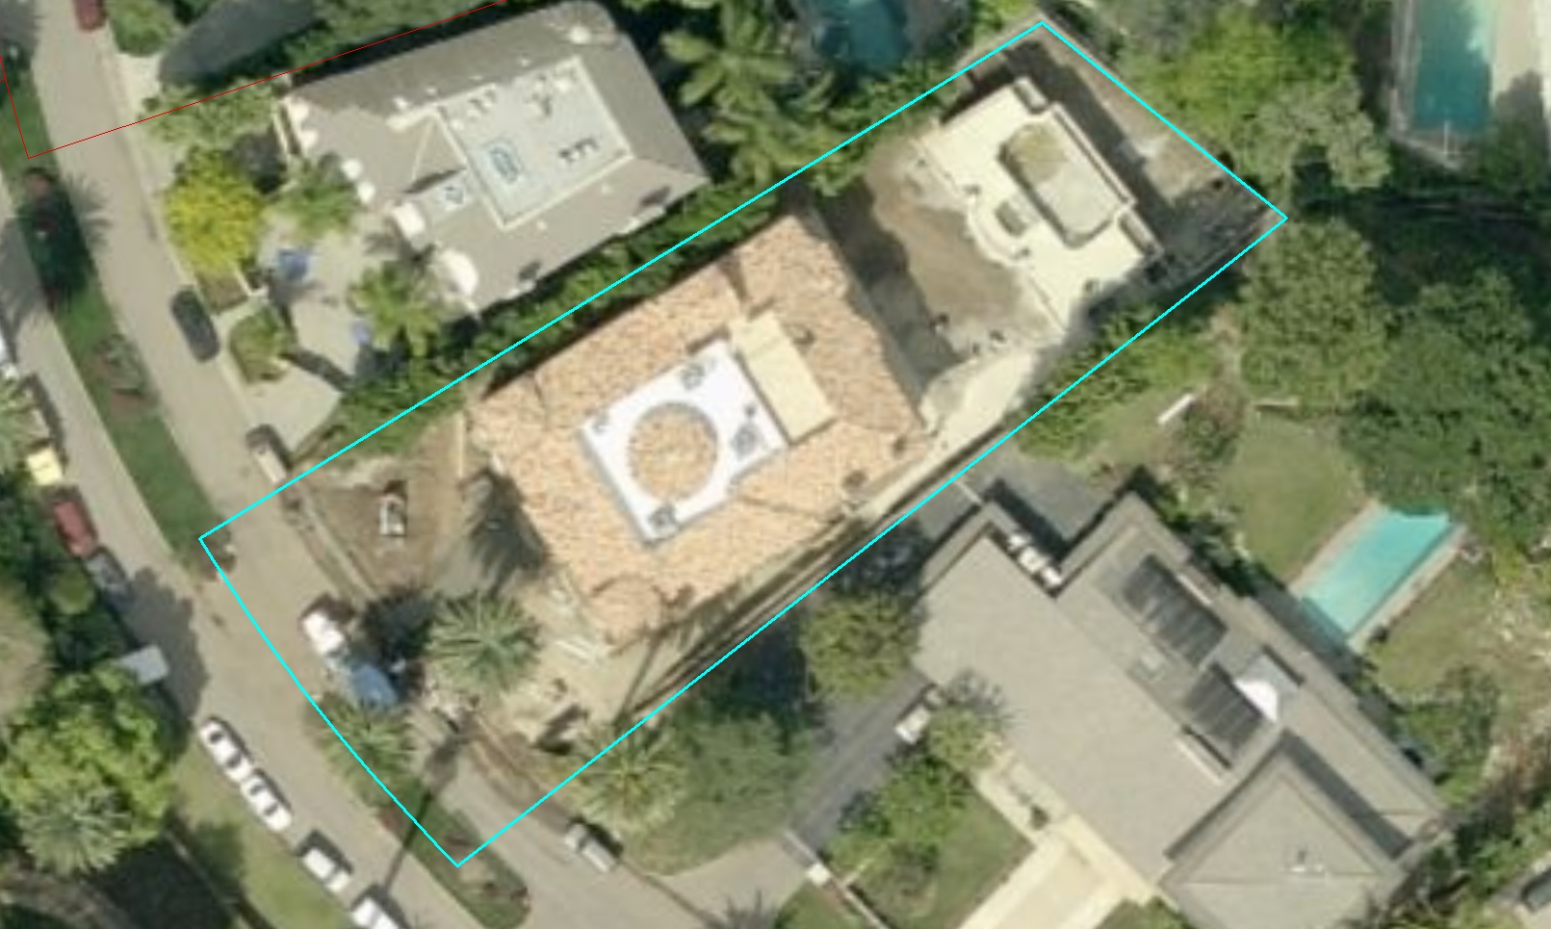
Increased floor plan means less green cover
Mansionization
Mega Homes
McMansions
Monster Homes
Introduction | 7

Slide 8
Single family neighborhoods are critical to nature
Introduction| 8

Slide 9
Research Questions
How has green cover changed on parcels for which the permitted building footprints increased compared with those for which no change was recorded?
How has the rate of building modification and associated changes in green cover varied across the 20 most populous cities in the Los Angeles Basin?
How much has green cover changed across the metropolitan region as a result of these changing building footprints in single-family neighborhoods?
Research Questions | 9

Slide 10
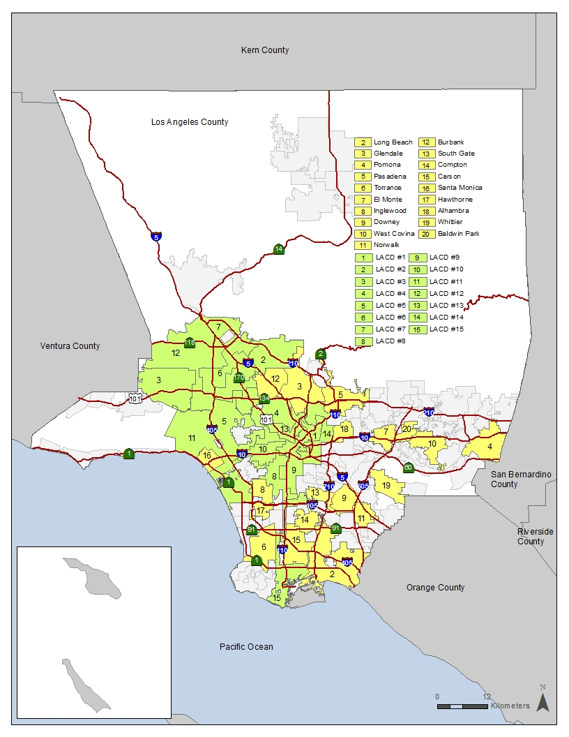
Research Design
20 largest cities
1060 samples (Building addition)
680 samples (No building addition)
Measured land covers in 2000 and 2008 aerial images
Methods | 10

Slide 11
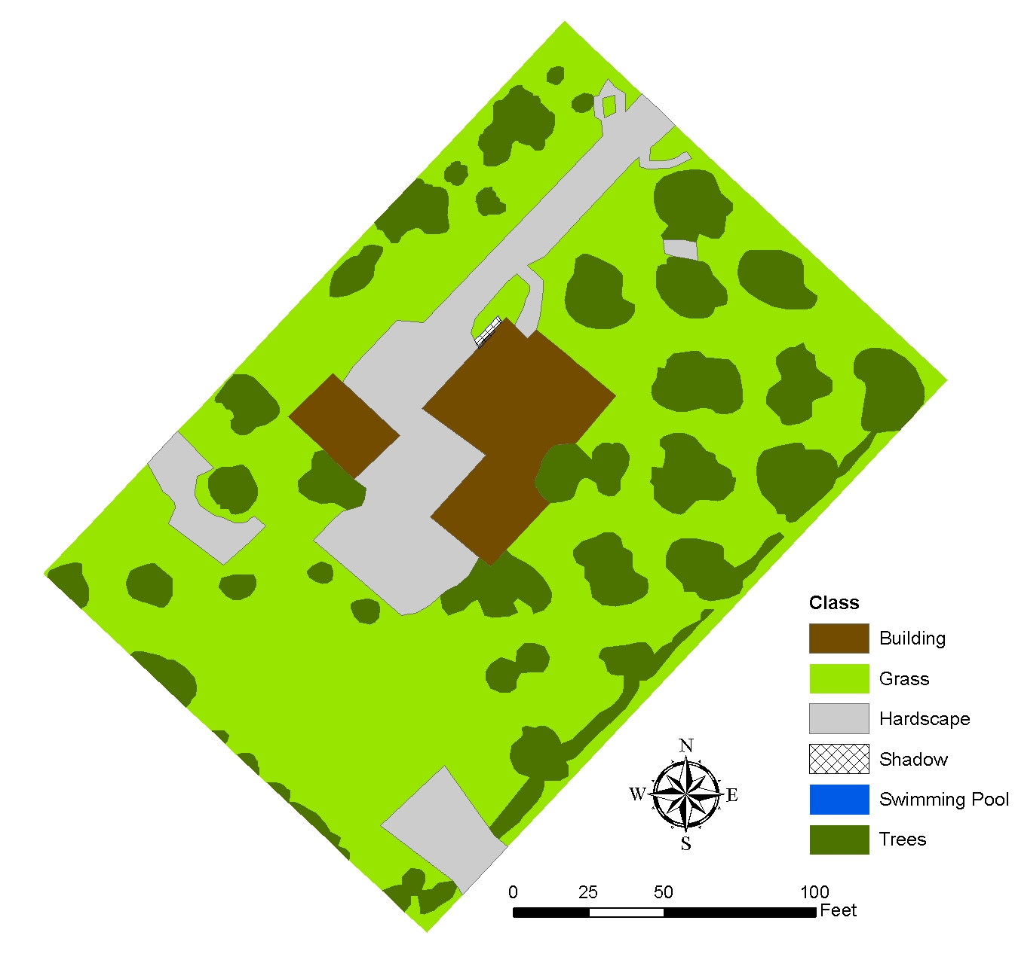
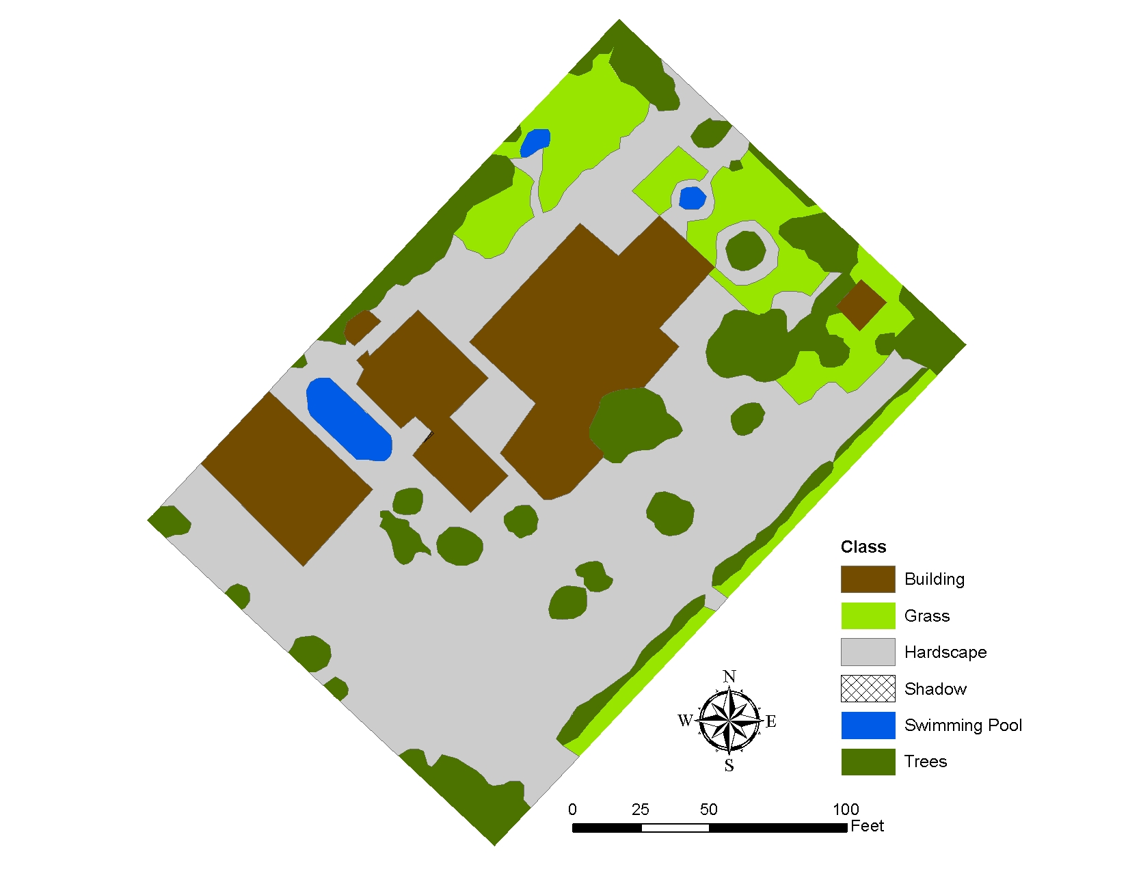
Sample of Measured Land Cover
Method | 11

Slide 12
Housing Statistics
Cities / council districts | No. of single family homes | Fraction of homes modified (%) | No. of modified homes | No. of modified homes sampled | No. of other homes sampled
Los Angeles | 346,006 | 9 | 30,756 | 463 | 300
Long Beach | 51,497 | 11 | 5,733 | 57 | 20
Glendale | 18,133 | 6 | 1,101 | 30 | 20
Pomona | 18,307 | 5 | 993 | 30 | 20
Pasadena | 16,923 | 9 | 1,597 | 30 | 20
Torrance | 25,275 | 8 | 2,099 | 30 | 20
El Monte | 7,992 | 8 | 665 | 30 | 20
Inglewood | 9,798 | 8 | 792 | 30 | 20
Downey | 14,134 | 10 | 1,477 | 30 | 20
West Covina | 14,628 | 7 | 962 | 30 | 20
Norwalk | 18,694 | 10 | 1,789 | 30 | 20
Burbank | 14,190 | 13 | 1,797 | 30 | 20
South Gate | 9,631 | 10 | 1,000 | 30 | 20
Compton | 14,226 | 6 | 898 | 30 | 20
Carson | 16,052 | 10 | 1,568 | 30 | 20
Santa Monica | 6,055 | 13 | 763 | 30 | 20
Hawthorne | 6,030 | 7 | 435 | 30 | 20
Alhambra | 8,996 | 8 | 740 | 30 | 20
Whittier | 13,299 | 9 | 1,138 | 30 | 20
Baldwin Park | 9,214 | 10 | 910 | 30 | 20
Totals | 639,080 | 9 | 57,213 | 1,060 | 680
Notes:
Let’s talk more about housing statistics
Our rule to select the stratified random samples is that the larger of a 1% or 30-home random sample was used to sample homes when the Los Angeles County Office of the Assessor recorded a change in building square footage
For homes at which no change had been recorded, 20 homes were randomly sampled in each city.
However, as you can see the city of Los Angeles is big enough to be divided into 15 council districts.

Slide 13
Housing Statistics
Cities / council districts | No. of single family homes | Fraction of homes modified (%) | No. of modified homes | No. of modified homes sampled | No. of other homes sampled
Los Angeles | 346,006 | 9 | 30,756 | 463 | 300
CD #2 | 31,354 | 11 | 3,420 | 34 | 20
CD #7 | 22,642 | 10 | 2,205 | 30 | 20
CD #3 | 32,719 | 8 | 2,737 | 30 | 20
CD #12 | 31,815 | 7 | 2,369 | 30 | 20
CD #11 | 33,616 | 12 | 3,911 | 39 | 20
CD #4 | 17,038 | 8 | 1,289 | 30 | 20
CD #5 | 25,770 | 12 | 3,033 | 30 | 20
CD #15 | 26,898 | 8 | 2,103 | 30 | 20
CD #6 | 23,723 | 11 | 2,493 | 30 | 20
CD #9 | 13,156 | 8 | 1,003 | 30 | 20
CD #13 | 9,365 | 8 | 759 | 30 | 20
CD #8 | 31,083 | 8 | 2,485 | 30 | 20
CD #10 | 14,936 | 8 | 1,127 | 30 | 20
CD #14 | 23,704 | 6 | 1,432 | 30 | 20
CD #1 | 8,187 | 5 | 390 | 30 | 20
Notes:
That’s why we had 19 cities and 15 Los Angeles Council District
So, total 34 analysis units were implemented as you saw a map before.

Slide 14
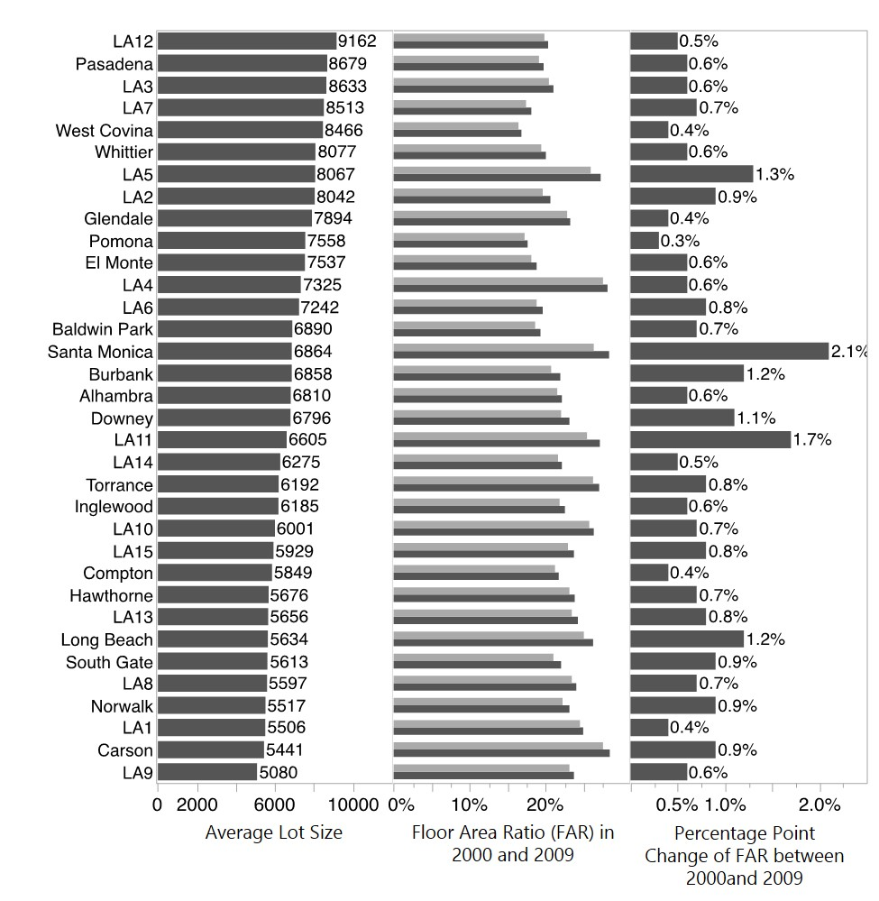
Lot, Floor Area Ratio, and Its changes
Method | 14

Slide 15
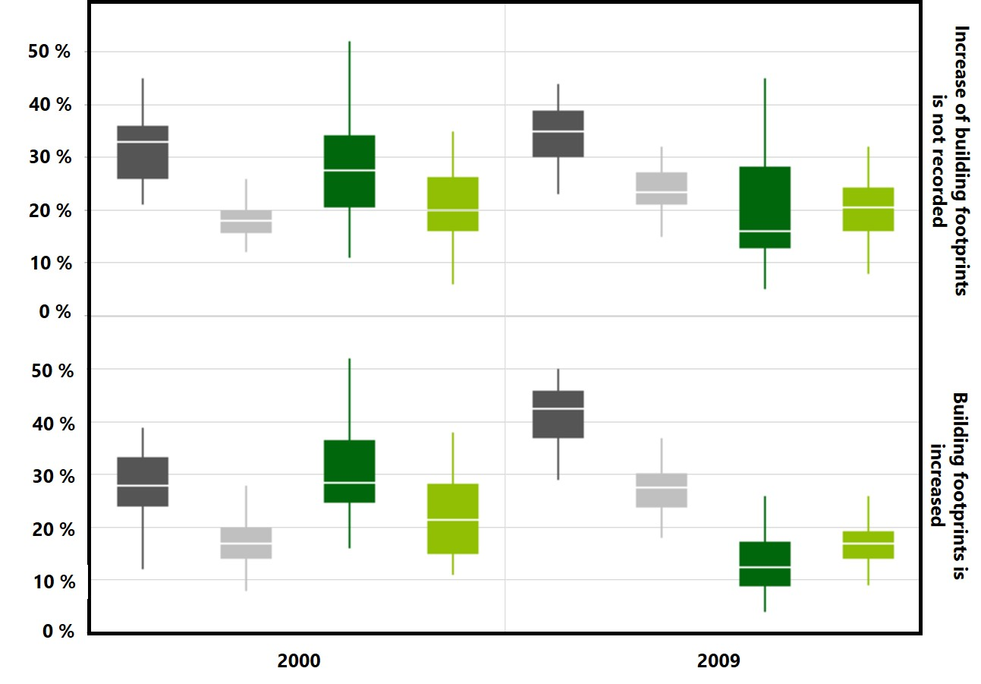
Building Added or Not?
Results | 15

Slide 16
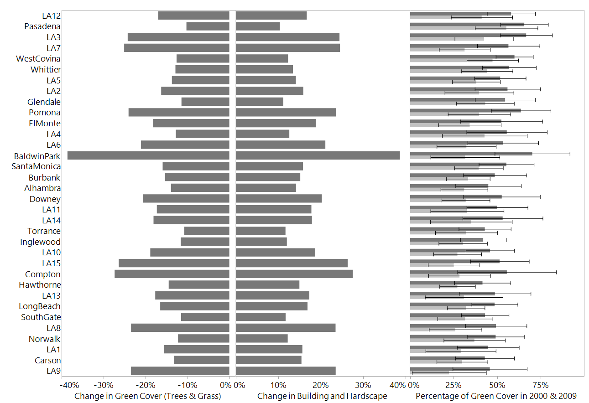
Permeable vs. Impervious
Method | 16

Slide 17
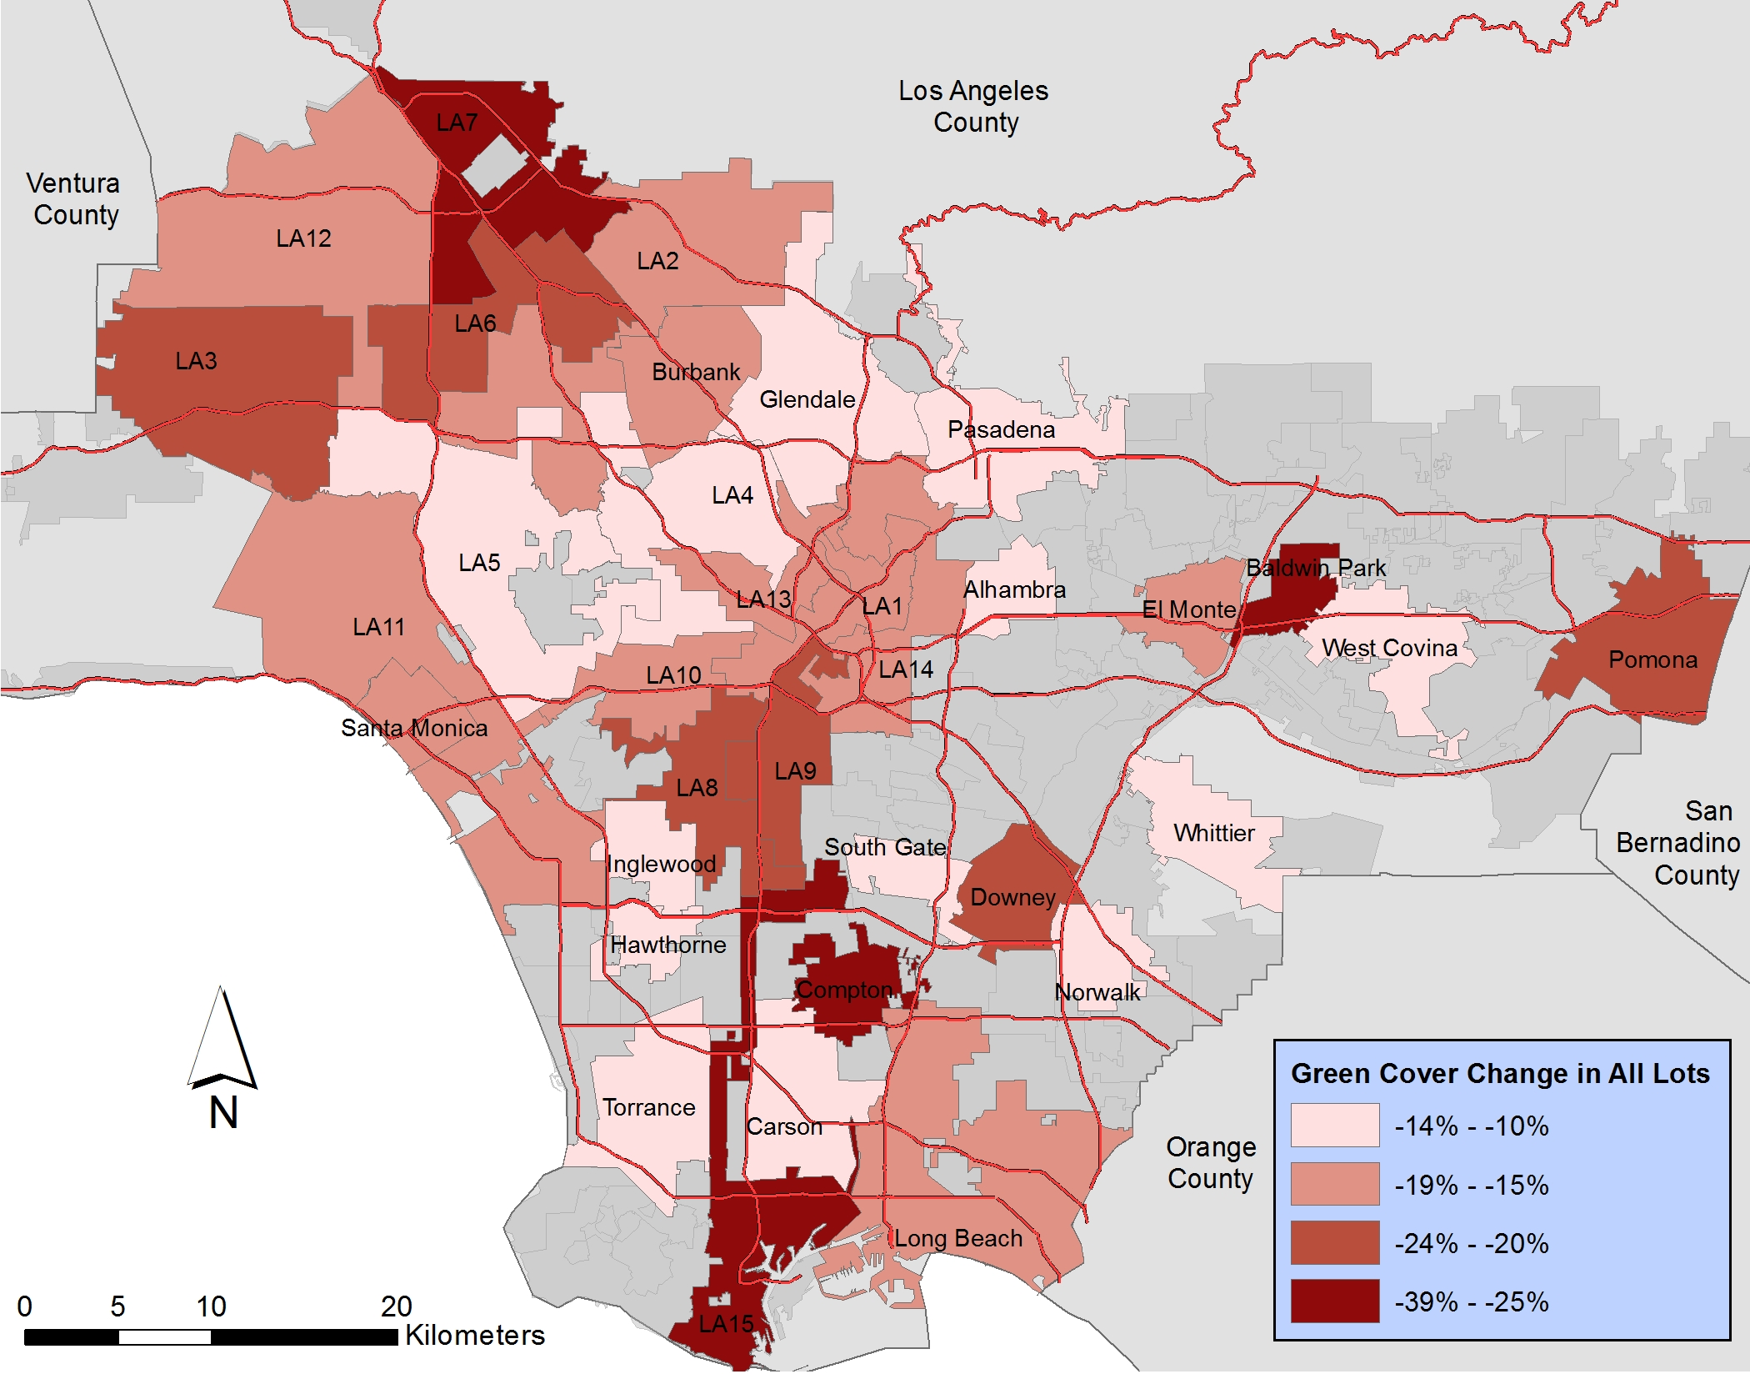
Loss of Green Cover
Results | 17

Slide 18
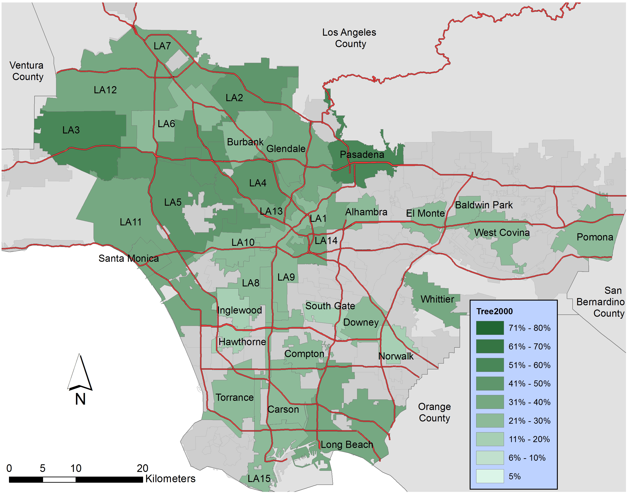
Green Cover in 2000
Results | 18

Slide 19
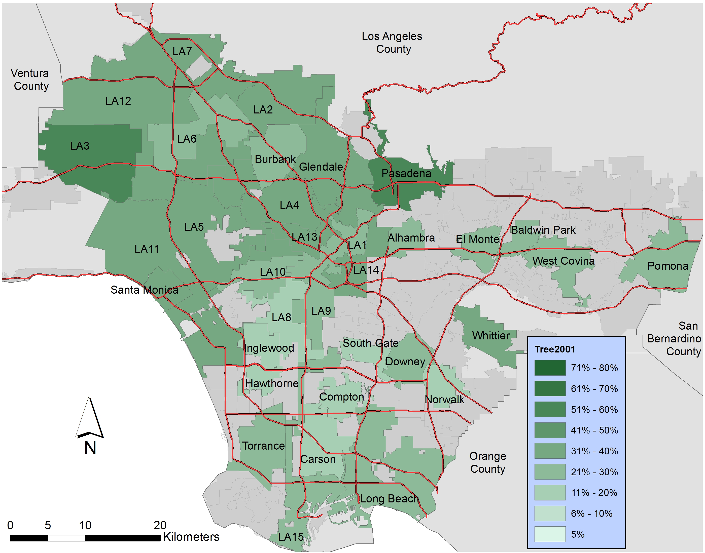
Green Cover in 2001
Results | 19

Slide 20
Green Cover in 2002
Results | 20

Slide 21
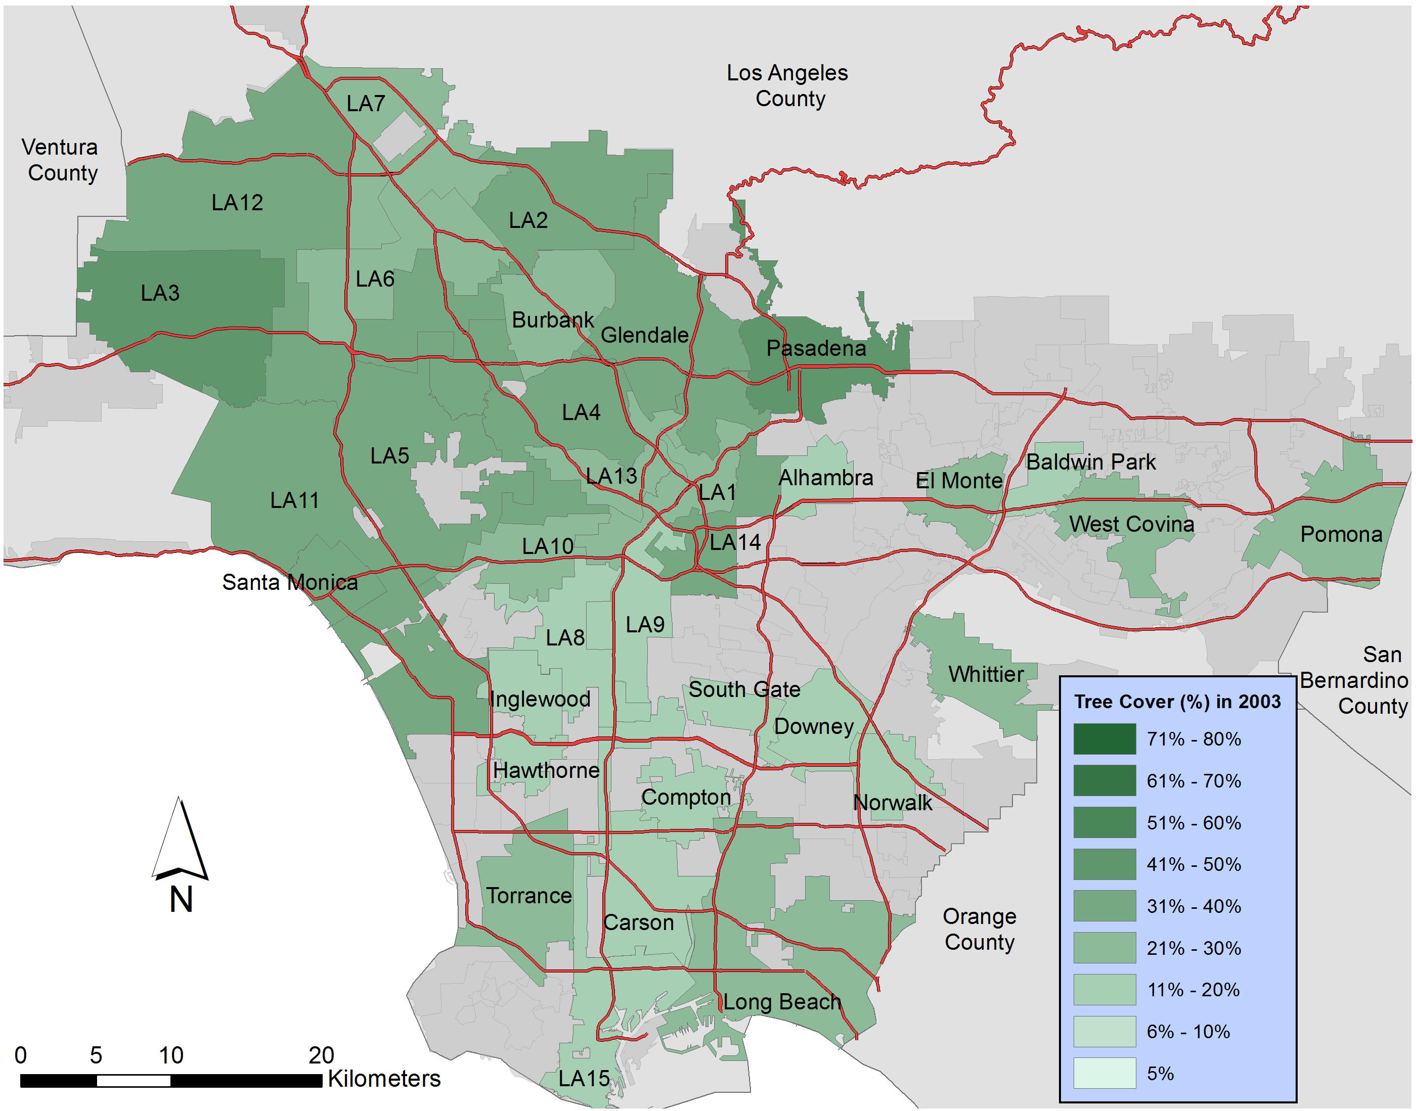
Green Cover in 2003
Results | 21

Slide 22
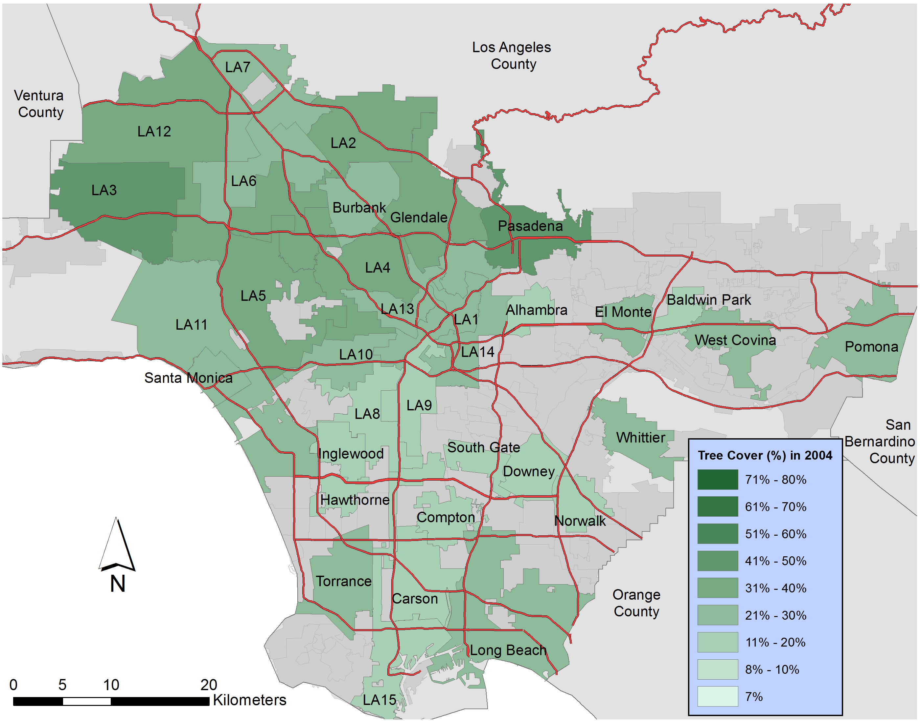
Green Cover in 2004
Results | 22

Slide 23
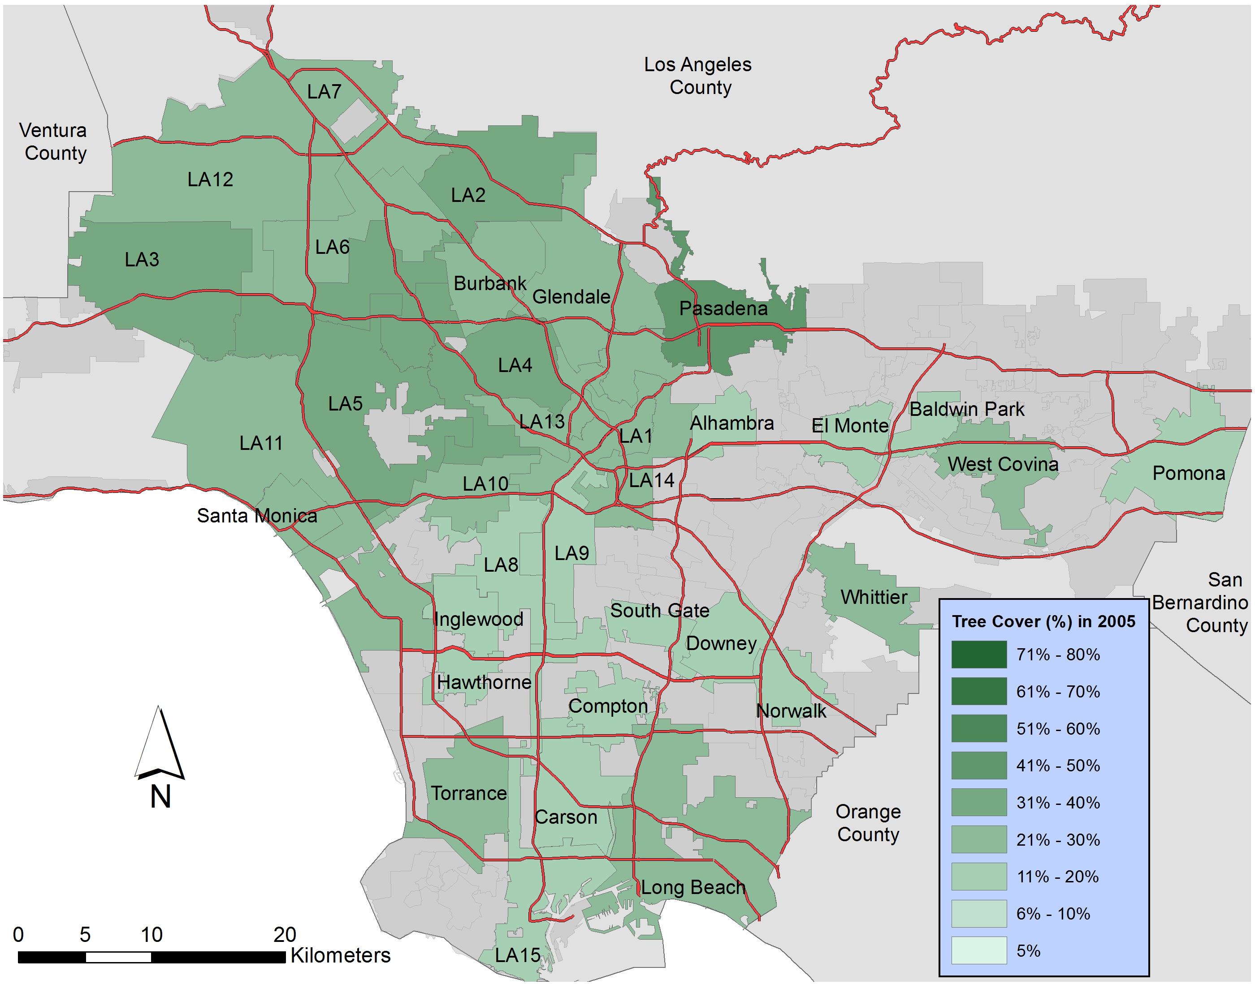
Green Cover in 2005
Results | 23

Slide 24
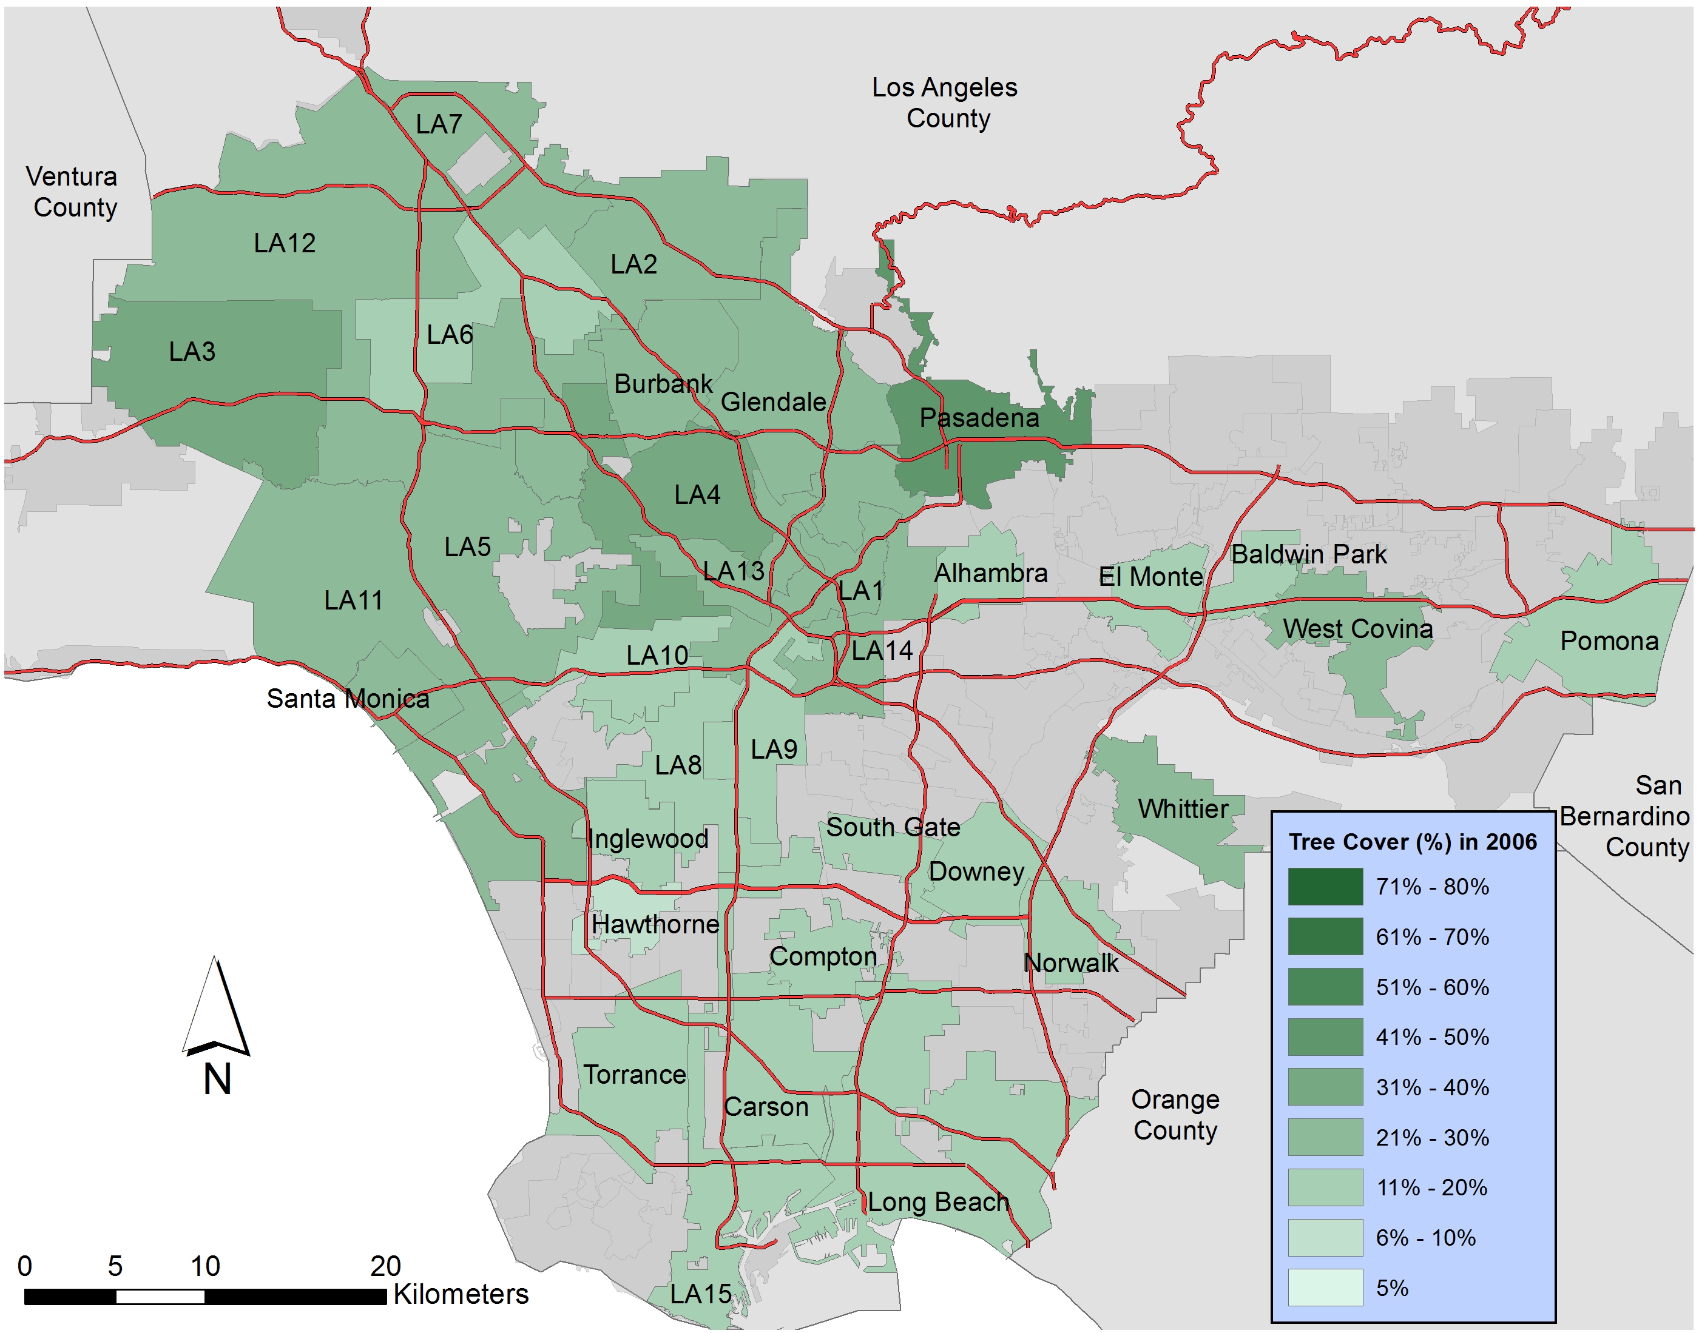
Green Cover in 2006
Results | 24

Slide 25
Green Cover in 2007
Results | 25

Slide 26
Green Cover in 2008
Results | 26

Slide 27
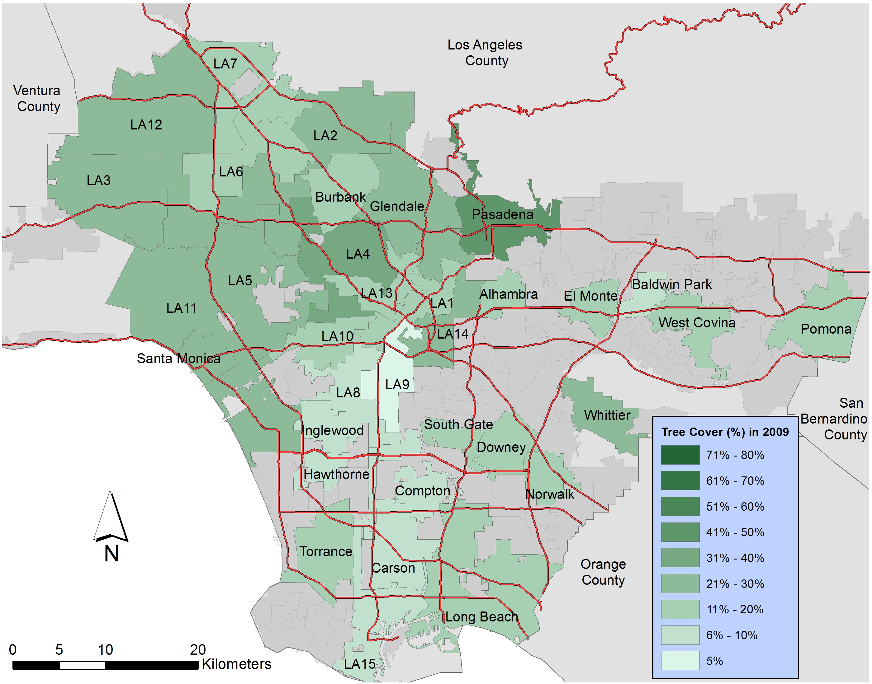
Green Cover in 2009
Results | 27

Slide 28
Conclusions
Lost 6.9 km² in Trees & 1.6 km² in Grass on single-family home lots for which additional building footprints were recorded
Lost 34.8 km² in Trees & 4.0 km² in Grass on single-family home lots for which additional building footprints were not recorded
Consequently, 1.2% annual decrease rate (Trees) & 0.1% annual decrease rate (Grass) on single family home lots.
Decreased area in tree and grass cover from 2000 to 2009 is larger than Baldwin Park (17.5 km²) and Hawthorne (15.6 km²).
The results also indicate that approximately 290 km² of green cover will be lost by 2050.
Conclusion | 28

Slide 29
Conclusions
These results show magnitude of continuous urban development in LA County
Decrease of permeable surface occurred on single-family home for which additional building footprints were not recorded as well
Loss of substantial green cover everywhere
Reductions in environmental benefits
We need to have plans to protect our lives.
Conclusion | 29

Slide 30
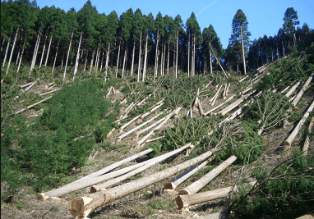
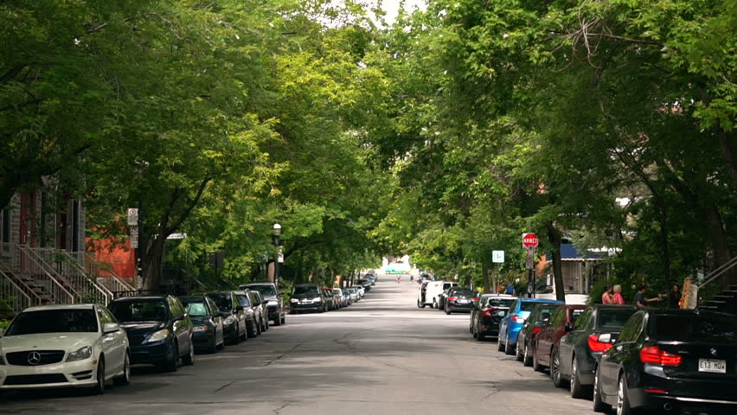
Why does it matter?
Biodiversity
Heat island mitigation
Reduced energy use
Stormwater infiltration/retention
Improved air quality
Neighborhood character
Aesthetics
Mental health
More livable & Healthy cities
https://i2.wp.com/natureconservation.in/wp-content/uploads/2016/01/391-1.png
https://ak8.picdn.net/shutterstock/videos/30215578/thumb/1.jpg
Conclusion | 30

Slide 31
Thank you
sujinlee@usc.edu
Thank you | 31

